Slide 1

SOLID
Principles which help to create good software architecture

Slide 2
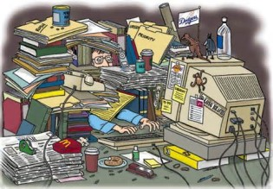
MESSY CODE
HARD TO:
UNDERSTAND
FIND AND FIX BUGS
ADD NEW FEATURES
ADAPT TO NEW TECHNOLOGY
RIGIDITY: HARD TO CHANGE
FRAGILITY: HIDDEN DEPENDENCIES, CHANGE AND BROKE
INMOBILITY: HARD TO DISANTANGLE COMPONENTS
VISCOSITY: IT’S SLOWER TO DO THE RIGHT THING THAN THE WRONG THING
OPACITY: HARD TO UNDERSTAND
NEEDLESS REPETITION
NEEDLESS REDUNDANCY

Slide 3
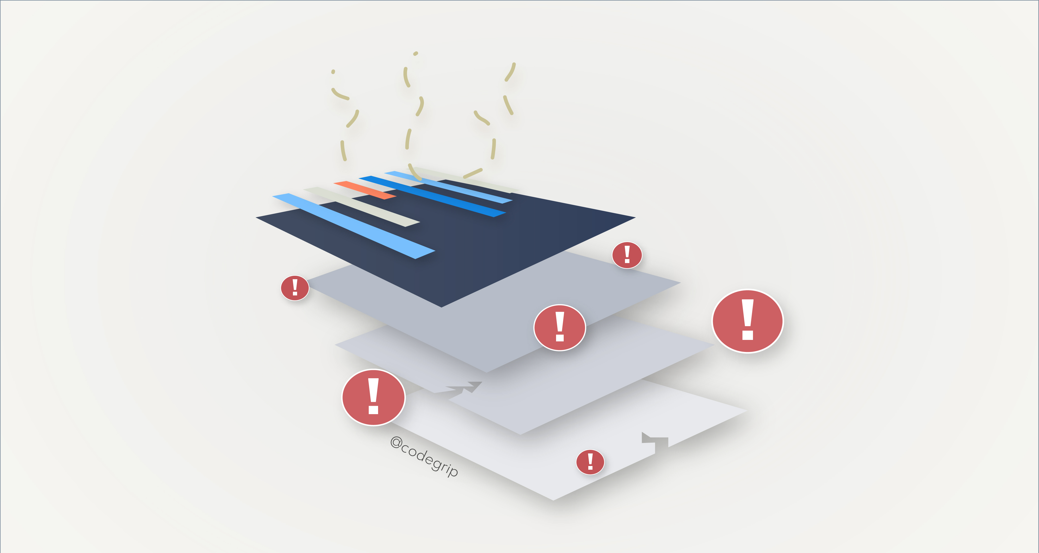
Code Smells
Duplication (DRY)
Long method
Big class
Feature envy
Useless comment
Poor name
Innapropiate intimacy
Shotgun surgery
Switch
God class
Primitive obsession
Refused bequest
….
https://www.codegrip.tech/productivity/everything-you-need-to-know-about-code-smells/

Slide 4
a good design…
Reveals intent
Adaptable
Tolerates evolution of business
Accept new technologies without undue cost
Manage dependencies
Intention-revealing names
Needs few comments
Separate concerns
Apply principles of class design (S.O.L.I.D.)
https://www.codegrip.tech/productivity/everything-you-need-to-know-about-code-smells/

Slide 5
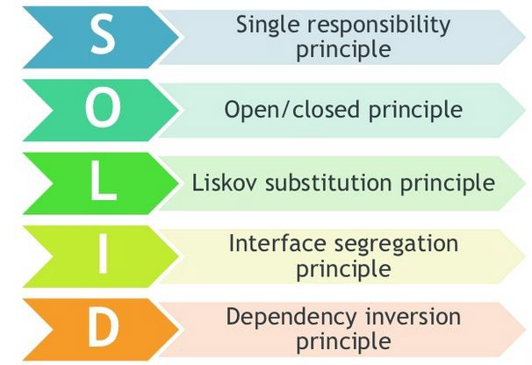
SOLID Principles
Make software more understandable, extendable, maintainable and testable.

Slide 6
Single Responsibility Principle

Slide 7
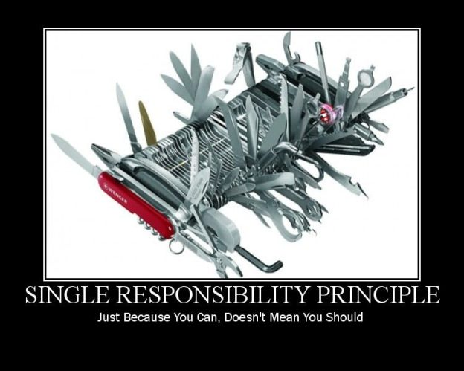
Single Responsibility Principle
A class/module should have ONE and ONLY ONE reason to change
ONE ACTOR that is the source of that change
This responsibility should be fully encapsulated.
When you have more than one responsibility in a class, it will generate a coupled code in your application.
Use simple naming, long function names imply that there is something fishy.
Big is bad, small is good….

Slide 8
Single Responsibility Principle - Benefits
Low coupling.
When it’s necessary to change a class, this will not impact any other classes.
Maintainable software.
If your class implements multiple responsibilities, they are no longer independent of each other. With this principle you avoid it.
Save time doing a refactor. if you have a coupled code and it’s necessary to do a big change, it will be necessary to test all the app again.
Classes that have only one responsibility are much easier to explain, understand and implement than the ones that provide a solution for everything.
Writing tests for code with single responsibility is easier.
What is the responsibility of your class/component/?

Slide 9
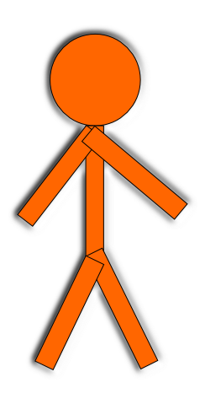
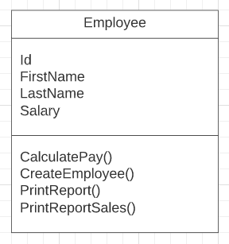

Employee Sample
Employee process in an application

Slide 10
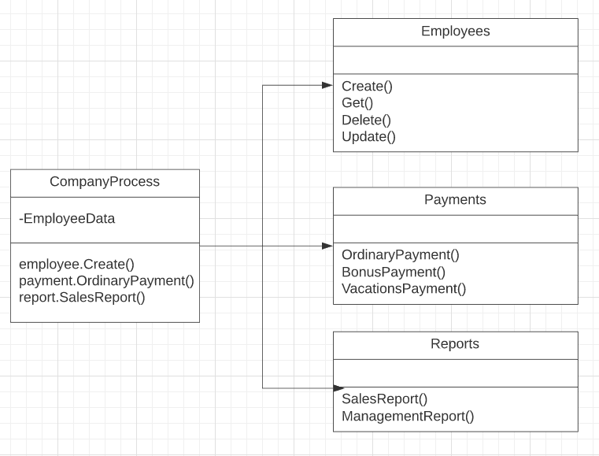

Employee Sample
Employee process in an application

Slide 11
Open/Closed Principle

Slide 12
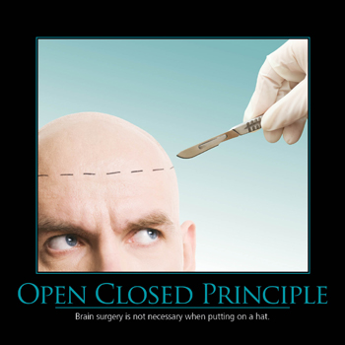
Open/Closed Principle
Robert C. Martin (1996) and others redefined the Open/Closed Principle base on polymorphism. Keep the concepts:
you will be able to add new functionality without changing the existing code
Change one class doesn’t mean change the classes that depends on it
BUT The interfaces are closed for modifications, and you can provide new implementations to extend the functionality of the software.
Polymorphic : the ability of a variable, function or object to take on multiple forms

Slide 13
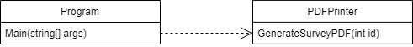
File Printer Sample
Simple program that allows to “print” a PDF file

Slide 14
File Printer Sample
Simple program that allows to “print” a PDF file
Now the client wants to “print” a friendly message while the PDF is been generating
Single responsibility AWESOME!!!
But what happens with the Open/Closed principle?

Slide 15
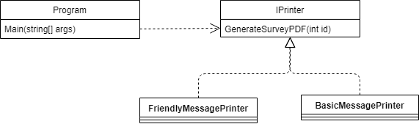
File Printer Sample
Now the client wants both message and they are thinking about the third one
Let’s keep Single responsibility and Open/closed principles

Slide 16
Liskov Substitution Principle

Slide 17
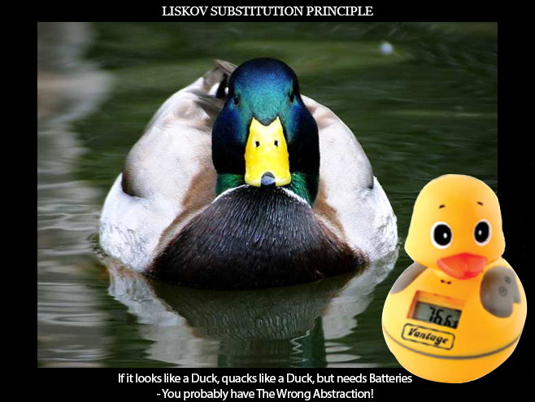
What is LSP?
Named for Barbara Liskov, who first described the principle in 1988.
“Subtypes must be substitable for their base types”

Slide 18
What is LSP?
Always for inheritance we read and use the IS-A to describe child classes.
LSP suggest that we should replace this with IS-SUBSTITABLE-FOR
Also, frequently uses unit test to specify expected behaviour of a method or class.
foreach (var emp in Employees)
{
if (emp is Manager)
{
……
}
if (emp is External)
{
……
}
}

Slide 19
Interface Segregation Principle

Slide 20
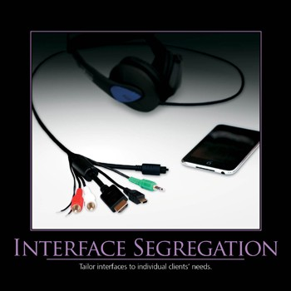
Interface Segregation Principle
A class should not be forced to depend on methods it does not use.
Correct abstraction is the key to Interface Segregation Principle
Keep cohesion
It’s important to know the business domain
This principle is easy to violate

Slide 21
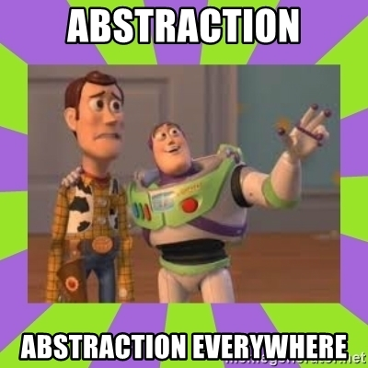
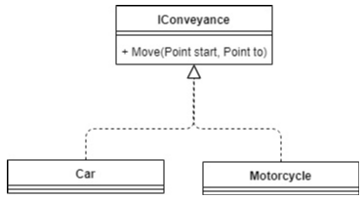
Interface Segregation Principle

Slide 22
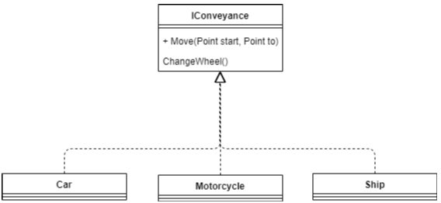
Interface Segregation Principle
“Do really need all the methods on this interface I’m using? If not, how can I break them into smaller interfaces?”.

Slide 23
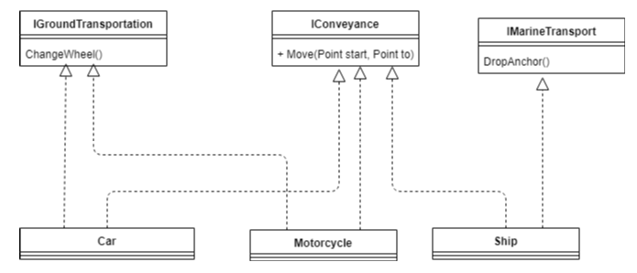
Interface Segregation Principle
“Do really need all the methods on this interface I’m using? If not, how can I break them into smaller interfaces?”.

Slide 24
Dependency Inversion

Slide 25


Dependency Inversion Principle
DIP States:
High level modules should not depend upon low level modules. Both should depend upon abstractions.
Abstractions should not depend upon details. Details should depend upon abstractions.
By Robert C. Martin 1995

Slide 26
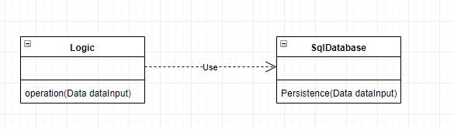
Normal Implementation (Not good)
Some issues:
The classes are strongly coupled. If you want to store the data in an Oracle or MySQL database, you have to modify the code of the Logic class. It means you are forced to make changes in an important and stable class (Logic), it just to modify the way of storing that data.
Difficulty to work with unit tests. You can not easily test the 'operation' method of the 'Logic' class without using the database.

Slide 27
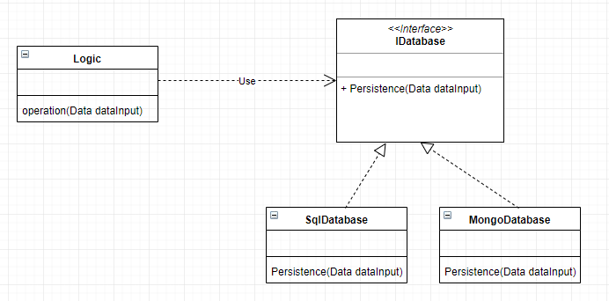
Good Implementation

